Slide 1
Data Masterclass for Senior Leaders
In partnership with

Slide 2
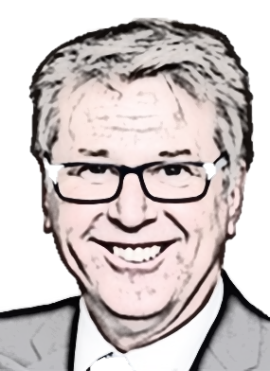
Why a Data Masterclass?
“Data and evidence is so critical in THE world we are now facing, with the complexity of social problems we are trying to solve, we don’t have the resources we used to have so we have to be focused and evidenced based”
Gavin Jones, Chief Executive Essex County Council
Notes:
Data and evidence is so critical in a world we are now facing with the complexity of social problems we are trying to solve, we don’t have the resources we used to have so we have to be focused and evidenced based.
There is currently more data in the world than ever before. We are living in a data revolution and we need to ensure that we harness this rich source of intelligence for public good and use it to help us make decisions.
Research from MIT suggests if just one board member is data literate it increased productivity / efficiency in a company by 11% and increased as more people are data literate. We know from the ONS ‘Opinions and Lifestyle’ survey in 2020 that nearly half (48%) of the working population use ‘basic’ data skills at work a lot, and just under a quarter (24%) use more advanced skills, such as data analysis and making graphs, a lot in their current job. We are not expecting all senior leaders to have advanced skills but we do believe that all leaders should understand the basics of good evidenced based decisions, know what type of data exists and how to get the best from it, being able to use and reason with evidence to help you make effective decisions.
For our organisations, investing in data literacy can have lots of benefits. It enables everyone to ask better questions.
To receive impactful insights rather than summary information. In turn, this provides customers with the tools to have a greater deal of confidence in their decisions, because the right evidence can provide assurance that the correct decisions will be taken. An ultimately, it results in a reduction of risk.
ecda is committed to ensuring public sector organisations in Essex have the skills to make better use of data and this Data Masterclass on offer to all senior leaders across Essex, will support this agenda by building data literacy across our organisations, helping you to put data and evidence at the heart of some of your most important decisions.

Slide 3
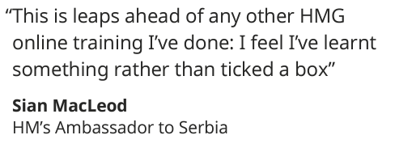
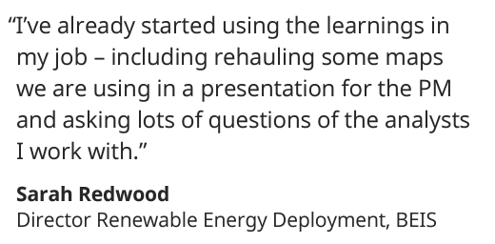
Our partnership
Masterclass created in 2021
Over 3,000 learners so far
Senior Civil Servants and leadership programme participants
Essex first area to engage with the Masterclass as a wider public sector
Be part of the equation
Notes:
This is pretty unique and special - Ecda as a partnership is the only organisation to have paired with ONS and made this content available to local government. It’s a unique experience and one that over 3,000 senior civil servants have already benefitted from.
Their feedback shows how much more informed and equipped they felt after to ask better question and challenge what they see, its helped them make better use of data and analytics in key challenges and given them confidence in making effective decision using an evidence.

Slide 4
What will you gain?
AWARENESS
INFORMATION
INSPIRATION
Understand what value you can get from data, what good evidence looks like and how to work with data professionals
Know how to read, work with, communicate and interpret and use data for effective evidence based decision making. Be aware of the risks, limitations and ethical considerations for using data
Recognise the growing role and importance of analytics and data science and what types of business problems it can help you to solve
The Data Masterclass is offered to all senior leaders across Essex to build data literacy in all organisations and will help you to put data and evidence at the heart of some of your most important decisions
Be part of the equation
Notes:
The Data Masterclass is offered to all senior leaders across Essex to build data literacy in all organisations and will help you to put data and evidence at the heart of some of your most important decisions
It will improve your awareness – helping you to understand what value you can get from data and how to work with data professionals.
You will be informed – understand how to read, work with, communicate and interpret data for effective decisions
And hopefully you will be inspired along the way – helping you recognise the growing role and importance of analytics & data science and the problems is can help you to solve.

Slide 5
What will be covered?
Week 1 data driven decision making
Week 2 Communicating and working with data
Week 3 Data Science and new frontiers
Understand why data matters in government, how it is critical in a diverse range of scenarios and what happens when we get it wrong. Exploring some of the practical considerations of data, and hear invaluable insights from senior leaders and analysts on how they work together to put data at the heart of their decision-making
Understand how to get to the bottom of the numbers behind the headline, assess the accuracy of claims, and how to demonstrate trustworthiness in communications. Learning from others on why appropriate use and format of data in communications is critical to convey a message with clarity and build trust
Hear about harnessing the power of data science techniques, how you can spot good opportunities to apply data science techniques to solve real challenges, and how you can be an effective leader when it comes to fostering data science projects within your department, learning from public and private sector companies at the cutting edge of applied analytics
Be part of the equation

Slide 6
How is it delivered?
The Masterclass is made up of a series of keynote talks delivered by world-leading experts, supported by powerful case studies from Essex, and national public and private sector examples.
The modules are designed to be completed flexibly around a busy schedule and can be accessed online from any device.
It can be approached in bitesize pieces, with each module and case study taking around 15 minutes to complete with each topic approximately 2-3 hours.
In total, the Masterclass takes around 10 hours. This can be completed over six weeks.
Be part of the equation
Notes:
The Masterclass centres around a series of 10 keynote talks delivered by world-leading experts including: Dr Hannah Fry, Sir David Spiegelhalter Sir Ian Diamond, Azeem Azhar.
These are supported by powerful case studies from government and the public sector, as well as supplementary materials to support learning and encourage cross organisation discussion on these important topics.
We are pleased to be able to launch the Masterclass at the Essex Leaders and Chief Executives Association and asking from nominations from all organisations for cohort 1.

Slide 7
How to get involved?
We are looking for nominations from all organisations for cohort 1 which will commence 19th September for 6 weeks
Cohort 1 is for leaders within your organisation Head of level and above
Express your interest, or nominate participants by 15 September by contacting ecda@essex.gov.uk
Additional cohorts will launch in November 2022, and January 2023 for colleagues throughout ECC.
Be part of the equation
Notes:
We are launching this today at the Essex Chief Executives Forum for you to be aware of what is available and what it will help you achieve
We are looking for nominations from all organisations for cohort 1 which will commence 19th September for 6 weeks – this is for leaders within your organisation (head of level of above)
We are asking you to share and promote this within your organisations - this is an ongoing programme that is available through the year for future cohorts to sign up to

Slide 8
A lot of the time data can prove your views to be spot on – domain knowledge is a critical part of intelligence. Sometimes it may challenge some conventional wisdom and make you think differently. BUT ALL of the time it can help build evidence that gives you the confidence to take action and reduces risk.
Be part of the equation
Notes:
What we want everyone to know is that whilst ….
A lot of the time data can proof your views to be spot on – domain knowledge is a critical part of intelligence. Sometimes it may challenge some conventional wisdom and make you think differently. BUT ALL of the time it can help build evidence that gives you the confidence to take action and reduces risk.

