Slide 1


Slide 2

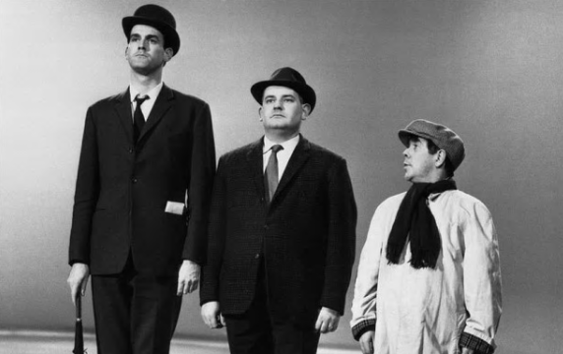
What is social mobility?
Broadly speaking… the link between a person’s class or income and the class or income of their parents.
Absolute or relative mobility?
Intergenerational.
Based on social class and income.

Slide 3
Social Mobility Commission:
Our Vision
To create a fair society where everyone can thrive, no matter what their background is
To reverse current trends in social mobility and instead see improvements in occupation and income mobility
To provide the foundations for our country to realise its economic and creative potential

Slide 4
What’s the scale of the problem?
Some progress
Absolute rates of child poverty have halved since 1997
Employment is at a record high
Educational inequalities are narrowing
And yet …
Social mobility has flat-lined
Only one in eight children from low-income background is likely to become a high earner as an adult
Those born in 60s, 70s, 80s and have lower incomes than their predecessors at the same age

Slide 5
Barriers to social mobility
CULTURAL BIASES
UNEQUAL start in life
regional inequalities
two-tiered labour market
inherited wealth
access to networks and connections
INACCESSIBLE housing market
huge educational disparities

Slide 6

Social Mobility Commission:
Our Role
Driving forward what works
Taskforces to deep dive into issues
Action focused Commissioners
Innovation funds

Slide 7
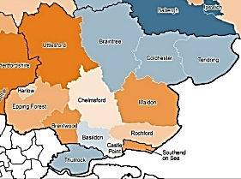
Social mobility in Essex

Slide 8
Social mobility in Essex
Local Authority | Overall score | Early Years | Schools | Youth | Working lives
Uttlesford | 20 | 46 | 25 | 78 | 63
Brentwood | 36 | 159 | 38 | 116 | 9
Maldon | 62 | 93 | 102 | 98 | 81
Epping Forest | 94 | 182 | 145 | 108 | 55
Harlow | 117 | 113 | 52 | 177 | 225
Rochford | 124 | 121 | 97 | 200 | 128
Chelmsford | 156 | 232 | 62 | 279 | 52
Castle Point | 158 | 205 | 63 | 157 | 239
Basildon | 181 | 119 | 197 | 211 | 152
Braintree | 211 | 255 | 118 | 207 | 173
Colchester | 214 | 197 | 108 | 284 | 171
Tendring | 222 | 130 | 211 | 178 | 281

Slide 9
What drives these variations?
Development by age 5
Quality of schools
Attainment at schools
Location and access to well-paid jobs
Proportion of low paid jobs
Home ownership

Slide 10
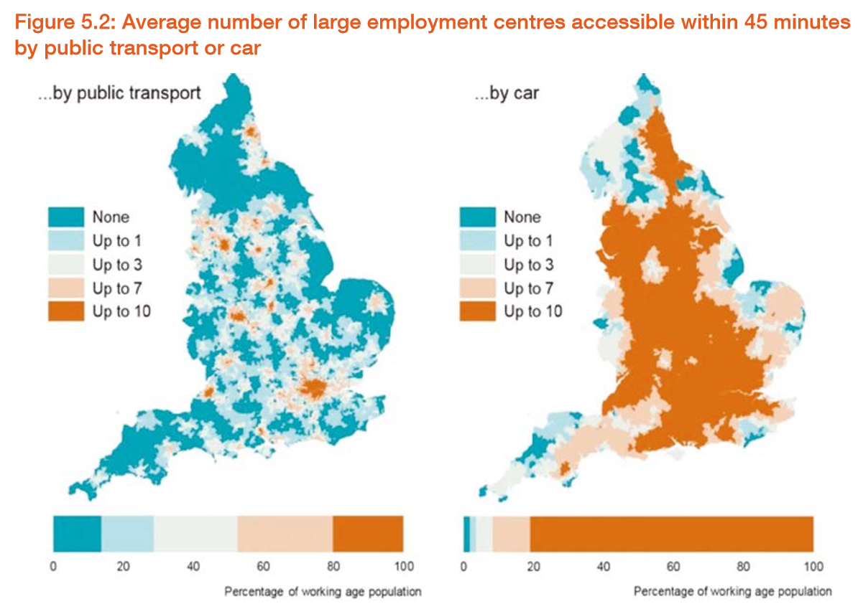
The role of infrastructure
Source: Department for Transport (2016) Road Use Statistics Great Britain 2016, statistical release.

Slide 11
Delivering for The Future of Essex
Priority 1: Need for greater awareness of training and employment opportunities in key growth sectors in Essex
Career Guides for both young people and adults
Essex Data Programme to intervene early and design and deliver services for early intervention
Education and Industry STEM Programme
Priority 2: Supporting social mobility in rural areas
Apprenticeship Promotion and Brokerage Hub
Enterprise Advisor Network to establish links between businesses and schools
In Work Progression Pilot in Harlow to help adults in low paid jobs to enhance their skills
Capital investment and curriculum development in FE

Slide 12
Shared prosperity for everyone?
What is your shared vision for social mobility in Essex?
What are your ideas for action now?
What are your ideas going forward?

